Slide 1
Workforce Development for Sustained Economic Growth
Marva Bryan, CEcD EDFP
Notes:
Notice: Please do not repurpose these slides without permission from DRA and IEDC

Slide 2
Objectives of Workforce Development
Prepare workforce with necessary skills
Job-specific, soft, and life skills
Current & anticipated labor needs
Remove barriers to employment
Expand labor force
Support job retention & career advancement
Connect workers & employers
Build talent pipelines

Slide 3
Workforce Matters…
Human capital is the key asset…
where developing, keeping, attracting, and maximizing the potential of people – from infanthood through elderhood – is the community difference maker for economic development.

Slide 4
Perspective
Likelihood of an adequate “pipeline” of talent =
#1 factor in locating businesses
Workforce and economic development have not traditionally been aligned:
Higher education and workforce development organizations have tended to cater to student preferences
People engaged in economic development are more attuned to business needs

Slide 5
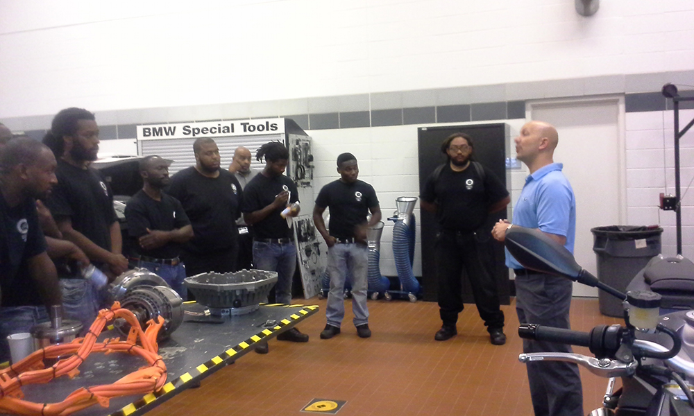
Challenge: Concern Regarding Quality & Quantity of Workforce
Labor pipeline is changing
Older, highly skilled “Baby Boomers” are retiring
New effect of the millennial generation
Mismatch in worker training
60% of all new jobs created will require skills that only 20% of the current workforce possess
Virgin Islands workers have limited resources for job training, career path development
Notes:
As older workers retire and the economy continues to shift towards knowledge, it is becoming more apparent that current workforce and education systems are not preparing the next generation workforce.

Slide 6
Federal Policy Environment
Workforce Innovation and Opportunity Act
“Job-driven model” - The federal approach to workforce policy has changed from a structure focused on individual preferences to one that takes into consideration the needs of business.
Workforce development programs must change to bridge demand & supply gap

Slide 7
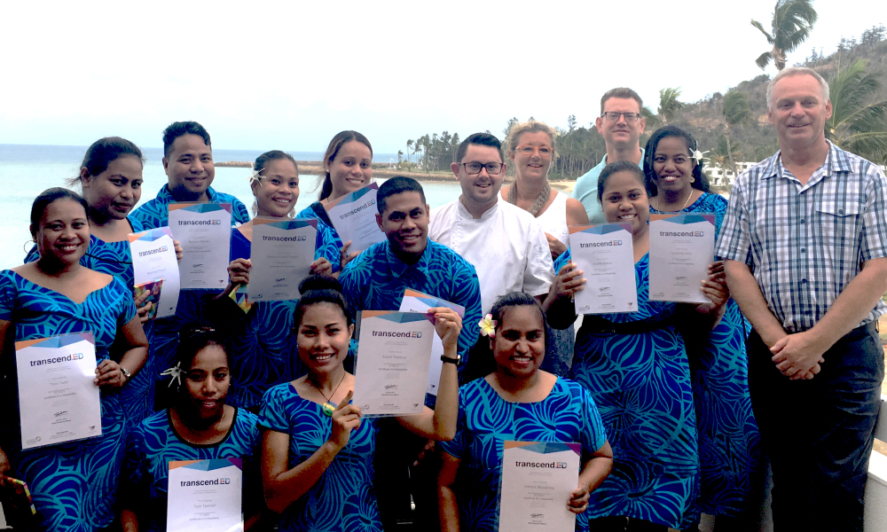
Many say the workforce development system needs re-thinking.
What feedback do you hear from businesses?
What distinct challenges are you facing as islands?
What is your level of involvement in workforce development?

Slide 8
Existing and Future Workforce
Many young people lack hard, soft, and life skills.
Educational achievement strongly linked to home environment and societal issues.
The earliest possible intervention is needed.
Greater career counseling and coaching needed.
Limited access to training is a challenge for islands.
Many workers are transportation-poor.
Housing and workforce tied together
Notes:
Slide from Joy Wilkins

Slide 9
Specific Challenges for Individuals
Displaced persons with non-transferrable skill sets
Workforce age persons who have not participated in the workforce for a significant length of time
People dealing with significant socioeconomic disparities
People facing cultural barriers
People with disabilities who wish to participate in the workforce
Persons with criminal records
Underemployed, unemployed due to business closures
Geographic and mobility challenges
Notes:
Hovensa closing in 2012/2013 and reopening of the refinery. What does it imply?

Slide 10
Key Questions for Discussion
What skills are represented by our local residents?
What skills are NOT in my community but needed by local industry?
Are there people who are not able to keep up with the pace of industry changes?
What can we do to help the unemployed who have been displaced by the hurricanes?
How can workforce pursue career paths?
What are you doing or can you do to assist?

Slide 11
Current Industry Clusters in U.S. Virgin Islands – 2017
Workforce | Percent (%)
Agriculture | 2.743
Industry | 11.694
Services | 85.562
Source: https://data.worldbank.org/indicator/SL.SRV.EMPL.ZS
Notes:
https://data.worldbank.org/indicator/SL.SRV.EMPL.ZS

Slide 12
Target Industry Clusters in USVI
Target Areas | Priority
Financial Services | High
Business Process Outsourcing (BPO) | Medium
High-value Manufacturing | Medium & High
Transportation & Logistics | High
Information Technology | High
Agribusiness | High
Tourism | High
https://www.usvieda.org/sites/default/files/pdf_document/TIS_2014_0.pdf
Notes:
https://www.google.com/search?q=image+results+TARGET+INDUSTRY++virgin+islands&tbm=isch&tbo=u&source=univ&sa=X&ved=0ahUKEwiEodKH3e_bAhXhxlkKHZuCCaYQsAQIRA&biw=1280&bih=869#imgrc=CROnYnqeZUewqM:

Slide 13
Who are the partners?
Graphic credit: Workforce Systems Associates

Slide 14
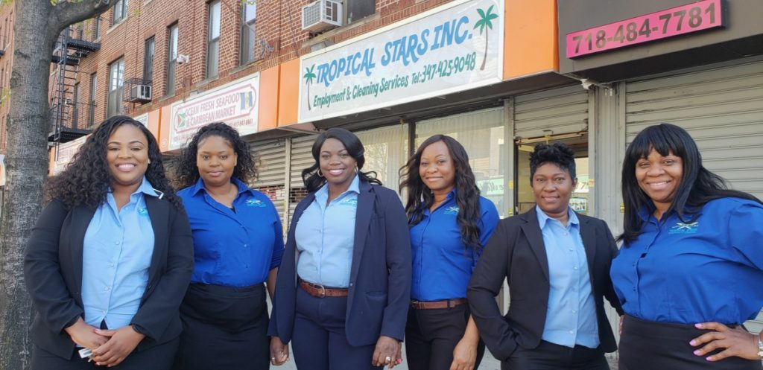
Talent Retention and Recruitment
Discussion:
How can you be actively engaged in talent recruitment and retention?
What kinds of services are available or should be available in your region to attract and keep talent?

Slide 15
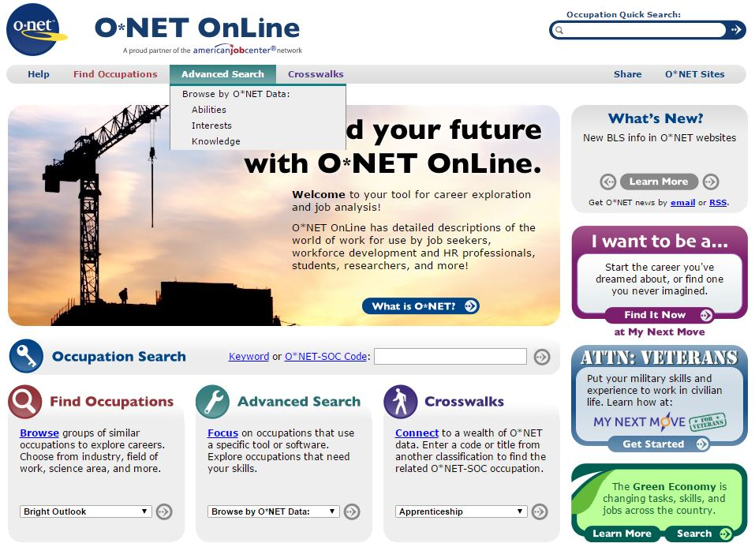
Tool to Expand Local Workforce by Helping Adults
Developing skills for youth (high school)
Displaced workers
Military personnel leaving the service
Returning workers
U.S. Department of Labor:
www.onetonline.org
https://www.mynextmove.org/vets/

Slide 16
More Workforce Development Resources
U.S. Department of Labor www.doleta.gov
Workforce One www.workforce3one.org
Career Onestop www.careeronestop.org
U.S. Bureau of Labor Statistics www.bls.gov
U.S. Department of Commerce (DOC) www.doc.gov
U.S. Department of Education (DOE) www.doe.gov
Small Business Administration (SBA) www.sba.gov
Questions?
Notes:
Mickie will share other engagement from available federal agency training

