Slide 1
Thinking Strategically about Your Economy & the Future
Marva Bryan, CEcD EDFP
Notes:
Notice: Please do not repurpose these slides without permission from DRA and IEDC

Slide 2
Call for Action 1
Every community has the potential to support existing industries, nurture and grow start-up firms, attract new dollars, and develop a sense of community…
…all of which will eventually improve the community’s tax base.
However, not every community is “ready”…
Notes:
Slide from Joy Wilkins

Slide 3
Why You Need Integrated Strategic Plans
Essential in building consensus and support - both internally and externally
Helps figure out what's possible, and how you might achieve it
Is your roadmap to move forward, show progress and celebrate success
Notes:
Internally because if your outreach is successful - if you get citizens to the meetings, if you do surveys, if you let everyone show up, but don't let some dominate and others go unheard - you will build community support. And externally because when you go for funding or assistance, having a developed strategy in the plan shows that you have internal support and clear vision. It's necessary.

Slide 4
Strategic Plan - Must Haves
Purpose - a shared sense of urgency
Champions and leadership
Collaboration and buy-in
Good data
Realistic goals
Notes:
This is a good discussion slide too. It would be good to have an example of a Strategic Plan that came from a shared sense of urgency.
https://www.cityofvancouver.us/citycouncil/page/strategic-plan

Slide 5
What Strategic Planning is NOT…
An event
About planning meetings
Developing a great, well-written report
Fulfilling a grant or regulatory requirement
Notes:
Slide from Joy Wilkins

Slide 6
Instead, Strategic Planning is About…
Understanding and optimizing your people equation
Creating a culture for strategic thinking…for regularly and creatively reinventing your future together
Developing your quality of place
Most importantly…developing your sense of community
Notes:
Slide from Joy Wilkins

Slide 7
PLACE MATTERS…
WHERE PEOPLE WANT TO BE IS MORE AND MORE DRIVING WHERE ECONOMIC DEVELOPMENT HAPPENS...
“Quality of place” considerations are critical site selection criteria to consider for business creation, retention, expansion, and recruitment
Simply put, community competitiveness in the global economy is driven by its quality of place
Notes:
Slide from Joy Wilkins

Slide 8
Importance of the Leadership Team
guide
organize
manage
bridge
oversee
setting overall direction
structuring the process
identifying & maintaining resources
connecting people with people & resources
providing ongoing oversight

Slide 9
Choosing leaders for strategic planning
Well-respected by community
Preferably both the public and private sector to give mixed perspectives
Known for getting things done & done well
Successful in launching new ventures
Easily able to recruit others to join in
Reputation for being fair, ethical
Thought of as respectful of others

Slide 10
CEDS: Comprehensive Economic Development Strategy
U.S. Economic Development Administration defines CEDS as “a strategy-driven plan for regional economic development”
CEDS is a framework for collaboration and action on regional economic development initiatives
Helps prove priorities when applying for grants
New requirement: resiliency measures to avoid shocks, recover from natural disasters like what you have experienced
Content guidelines can be found on the EDA website
https://www.eda.gov/ceds/

Slide 11
Strategic Planning Process
Organizing & pre-planning
identify & recruit players & stakeholders
create organizational structure
determine resources
Visioning
Assessing community & economic competitiveness
evaluate & define your situation
Identifying issues & formulating realistic goals, objectives & strategies
Laying out the strategies and implementation plans

Slide 12
Key Elements
DATA: Where are we? What are the trends saying about our economy?
What's standing in our way? The SWOT analysis
Where do we want to go? - VISION

Slide 13
Key Elements
Strategies and Actions to get there
ACTION PLAN
Who's going to do what
ROLES/PARTNERS
How do we know if it's working
METRICS

Slide 14
Key Element 1: Data
Qualitative and quantitative info
Economic dashboard indicators
Analysis of trends
Strengths and weaknesses
SWOT analysis, discussion of assets
Comparative advantages & challenges
Location quotients, import/export data
Notes:
Joy Wilkins edited title

Slide 15
Understand Your Economy
Population Size and growth, age, education level
https://www.census.gov/quickfacts/fact/table/US/PST045217
Labor Force Statistics
Participation, occupations, skills, commuter characteristics
Virgin Islands https://www.bls.gov/eag/eag.vi.htm
https://www.vidolviews.org/vosnet/lmi/default.aspx?pu=1&plang=E
Gather as much data as possible on local and regional economic conditions
Unemployment, types and sizes of firms/industries, wages, income, new business starts, retail sales, housing prices, types of imports and exports, number of businesses closed

Slide 16
Labor Force and Employment
2016 Virgin Islands Labor Force Estimates
 |  | Jan | Feb | Mar | Apr | May | Jun | Jul | Aug | Sep | Oct | Nov | Dec | Annual Average
Virgin Islands | Labor Force | 47,856 | 48,133 | 48,131 | 48,148 | 48,235 | 48,151 | 47,897 | 48,031 | 47,659 | 48,188 | 48,191 | 48,384 | 11.1
 | Employment | 42,311 | 42,713 | 42,722 | 42,815 | 42,984 | 42,846 | 43,173 | 42,611 | 42,185 | 42,717 | 42,958 | 43,197
 | Unemployment | 5,545 | 5,420 | 5,409 | 5,333 | 5,251 | 5,305 | 4,724 | 5,420 | 5,474 | 5,471 | 5,233 | 5,187
 | Unemployment Rate | 11.6 | 11.3 | 11.2 | 11.1 | 10.9 | 11.0 | 9.9 | 11.3 | 11.5 | 11.4 | 10.9 | 10.7
St. Croix | Labor Force | 21,801 | 21,814 | 21,854 | 21,856 | 21,888 | 21,812 | 21,789 | 21,823 | 21,423 | 21,671 | 21,843 | 21,998 | 11.1
 | Employment | 19,178 | 19,360 | 19,364 | 19,406 | 19,483 | 19,420 | 19,568 | 19,314 | 19,121 | 19,362 | 19,471 | 19,579
 | Unemployment | 2,623 | 2,454 | 2,490 | 2,450 | 2,405 | 2,392 | 2,221 | 2,509 | 2,302 | 2,309 | 2,372 | 2,419
 | Unemployment Rate | 12.0 | 11.2 | 11.4 | 11.2 | 11.0 | 11.0 | 10.2 | 11.5 | 10.7 | 10.7 | 10.9 | 11.0
St. Thomas/ St. John | Labor Force | 26,055 | 26,319 | 26,277 | 26,292 | 26,347 | 26,339 | 26,108 | 26,208 | 26,236 | 26,517 | 26,348 | 26,386 | 11.1
 | Employment | 23,133 | 23,353 | 23,358 | 23,409 | 23,501 | 23,426 | 23,605 | 23,297 | 23,064 | 23,355 | 23,487 | 23,618
 | Unemployment | 2,922 | 2,966 | 2,919 | 2,883 | 2,846 | 2,913 | 2,503 | 2,911 | 3,172 | 3,162 | 2,861 | 2,768
 | Unemployment Rate | 11.2 | 11.3 | 11.1 | 11.0 | 10.8 | 11.1 | 9.6 | 11.1 | 12.1 | 11.9 | 10.9 | 10.5
Source: https://www.vidolviews.org/gsipub/index.asp?docid=668
Notes:
http://showmeinstitute.org/blog/employment-jobs/sad-state-missouris-labor-force-participation

Slide 17
Source: https://www.vidolviews.org/vosnet/analyzer/results.aspx?enc=HofuwY22SoLTS/uC+bpmizGZkm52zV+sR+lKAe/bUj0=

Slide 18
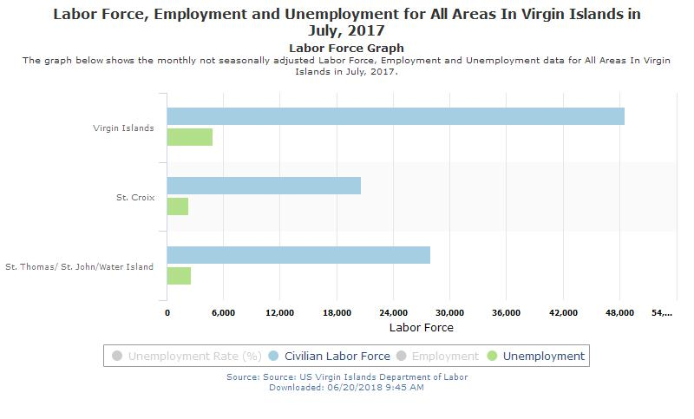
Source: https://www.vidolviews.org/vosnet/analyzer/results.aspx?enc=HofuwY22SoLTS/uC+bpmizGZkm52zV+sR+lKAe/bUj0=

Slide 19
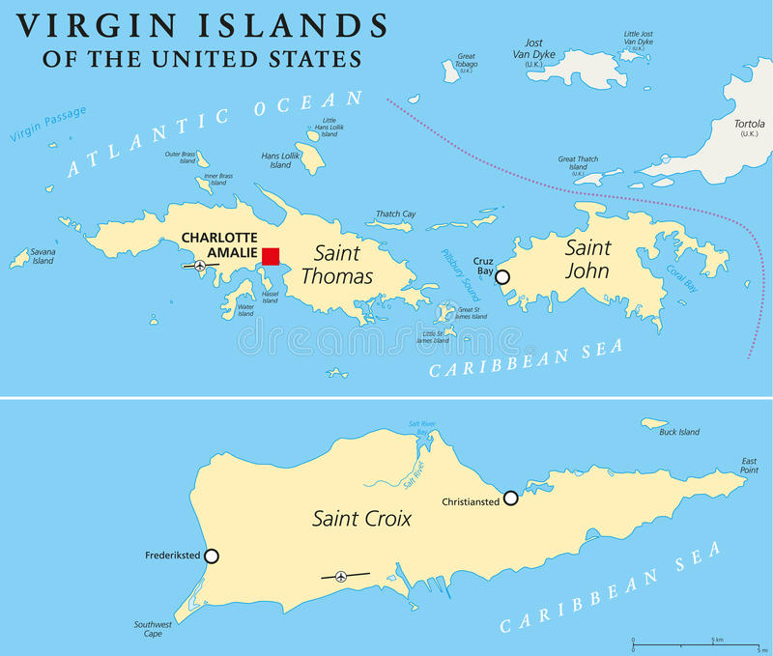
Your community’s place in the regional economy
How do you define your region?
How does the strength of your community depend on or impact others?
What assets do you contribute to the regional economy?
How does your performance compare?

Slide 20
Your Industry Clusters
Key Industries
Advanced Manufacturing
Financial Services
Information & Technology
Tourism & Hospitality
https://www.usvieda.org/node/589

Slide 21
Key Element 2: Vision
Where does your community want to be in ___ years?
Concise statement
Where community wants to be in definable future
Informs economic development activities
Encompasses worthwhile & important values
Influences individual thought & action
Notes:
Joy Wilkins edited slightly

Slide 22
Inclusiveness & Consensus Makes a Difference
Engage and involve the community
Seek feedback often
Strive for a thorough 360 degree view
Few projects succeed/sustain without it

Slide 23
Key Element 3: Analysis SWOT helps focus on priorities
Analyzes strengths, weaknesses, opportunities and threats – the SWOT
Recognize comparative advantages
Location quotients, clusters, export industries
Know your place in the regional economy

Slide 24
Strengths
Some examples
Available industrial, retail or office space
Intermodal transportation
Reputation as a “business friendly community”
Resources to support small businesses
Presence of clusters
Notes:
Factors that could serve as the basis for achieving the mission & vision of the strategic plan

Slide 25
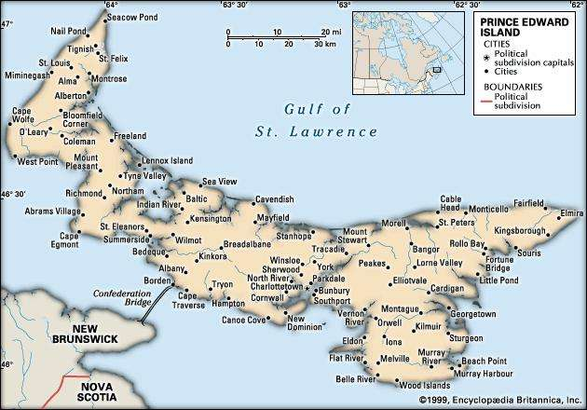
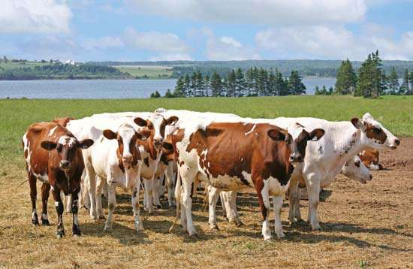
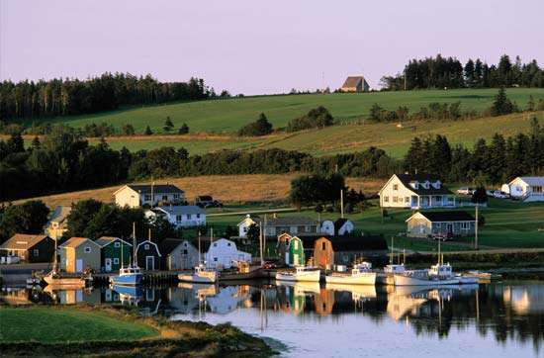
Example of an Island-based Economic Development Plan
Playing to Your Strengths
Prince Edward Island, Canada
Establishes 7 goals and 40 corresponding actions
Goal 1: Enhance Business Development
Goal 2: Strengthen Primary Sectors
Goal 3: Expanding Tourism
Goal 4: Environmental Conservation and the Rural Economy
Goal 5: Support Community Development and Capacity Building
Goal 6: Human Resources, Education and Essential Services
Goal 7: Increase development investments in areas of greatest need
Source: http://www.gov.pe.ca/photos/original/FARD_REDS.pdf
Notes:
In the 2008 Speech from the Throne, entitled “One Island Community, One Island Future,” the provincial government declared its intention to form a new department responsible for rural development and to produce a rural economic development strategy. Both the department and the strategy would be the first of their kind for Prince Edward Island.
Upon being elected, the provincial government immediately began to implement measures to assist rural Prince Edward Island. Subsequently, the Throne speech initiated the evolution of a more strategic, government-wide focus on rural issues.
The government’s first major priorities included:
(1) developing a province-wide broadband system;
(2) partnering in an industry-led process to articulate a new vision for the future of agriculture;
(3) launching programs to address access to capital issues in the fishery;
(4) mandating a review of land-use and local governance policy;
(5) fully funding the municipal equalization program and
(6) investing in, and stabilizing, rural health care.
Consultations In the summer of 2008, the government began working on the rural economic development strategy by undertaking foundational research and, in turn, extensive Island-wide consultations, including regional consultations, workshops, and an on-line survey.
Over 1,200 Islanders participated in the consultations, which took place between February and October, 2009. In July, regional consultations were held in Mill River, Crapaud, and Montague. A French-language consultation was held in Wellington. Over 200 people, representing private interests, sector organizations and development groups, attended the four sessions. The participants emphasized the need to focus on:
• economic development
• environmental conservation
• sustaining and improving the quality of life
• securing local involvement in implementing the Rural Action Plan
The Rural Action Plan represents the culmination of these efforts, combined with the input garnered from an extensive, province-wide consultation process that derived input from over 1,200 Islanders. The Plan sets out 40 Actions intended to focus on existing and new efforts to develop the rural economy.
The Actions are based on seven goals:
Goal 1: To create a sound basis for rural businesses to grow, for new ones to be formed and for new sectors to emerge.
Goal 2: To enable the growth of innovative, competitive and sustainable primary sectors, in order to ensure that they remain pillars of the rural economy and community for generations to come.
Goal 3: To augment rural areas of Prince Edward Island as tourist destinations; to expand and grow products, such as festivals and events, that complement the primary sectors and strengthen local culture, while increasing visitations Island-wide.
Goal 4: To improve the balance between the growth and health of primary industries and rural communities with the need for environmental conservation.
Goal 5: To invest in community development efforts and to strengthen community-based capacities.
Goal 6: To invest in education and the development of human resources in order to create opportunities, strengthen the base of Island industries and to share – to the fullest extent possible – the benefits of the ‘One Island Community’ principle.
Goal 7: To increase development investments in areas of greatest need in order to stimulate growth and opportunity.
https://www.princeedwardisland.ca/en
https://www.britannica.com/place/Prince-Edward-Island/images-videos

Slide 26
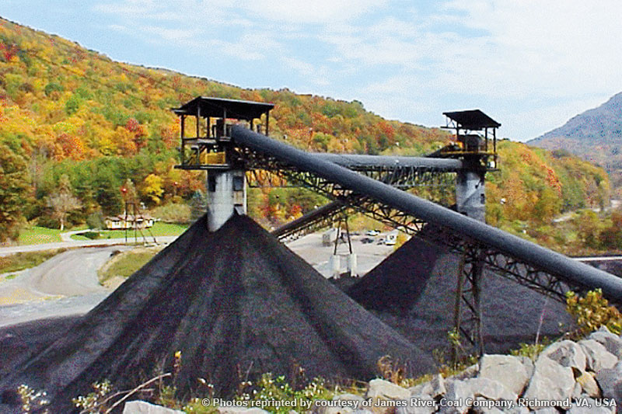
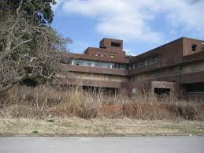
Weaknesses
Some examples
Reliance on one major employer or industry
Declining tax base – out migration
Out-dated or vacant buildings
Shortage of skilled workers
Notes:
Factors that could serve as the basis for achieving the mission & vision of the strategic plan

Slide 27
Addressing weaknesses: Northern Mariana Islands Strategic Plan for Tourism & Master Plan for Tourism Development
(LYNN’s NOTE: I have examples of strategic plans that I can show and talk about here.)

Slide 28
Opportunities
Areas where the application of resources could result in new developments beneficial to business and the community
Historic or natural assets
Development of new facilities
Local expertise and good work ethic
Issues that have community interest or support
Notes:
Factors that could serve as the basis for achieving the mission & vision of the strategic plan

Slide 29
Threats
Future events, that are often beyond local control, and that could lead to negative impacts
Regional, national or global economic shift
Natural or manmade disasters
Technological advances that make a product or service made in your community obsolete
Loss of a major industry
Notes:
Examples – the Savings and loan crisis in California, the collapse of the sub-prime mortgage market – the OPEC oil embargo

Slide 30
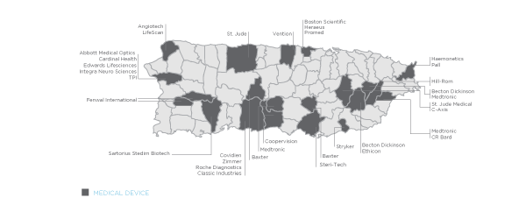
Dealing with a Threat:
Pharmaceutical Manufacturing in Puerto Rico
An industry of over 5 decades old that was boosted by a tax incentive
An expired federal tax incentive known as Section 936, allowed manufacturers to send profits to parent plants
One of the most important biopharmaceutical manufacturing centers in the world
Pharmaceutical products comprises more than half of manufacturing on the Island
​Over 20 different kinds pharmaceutical products are manufactured on the Island
Despite growth, there have been challenges due to the repeal of the incentive and Hurricane Maria
Notes:
Learn more at http://www.pridco.com/industries/Pages/Pharmaceutical.aspx
​A Hotspot for Pharmaceutical Manufacturing
Puerto Rico is one of the most important biopharmaceutical manufacturing centers in the world, with more than 50 years of experience in pharmaceutical manufacturing and 30-plus years of experience in sterile pharmaceutical manufacturing.
With 49 FDA-approved pharmaceutical plants scattered across the island, Puerto Rico is home to top multinational pharmaceutical companies, including Astra Zeneca, Abbott-Abbvie, Bristol-Meyers Squibb, Merck, Pfizer, Eli Lilly and numerous others. Many companies operate more than one site on the island.
Two dozen different kinds pharmaceutical products are manufactured in Puerto Rico: antihypertensive drugs, tranquilizers, laxatives, anti-diabetic drugs, vasodilators, antibiotics and contraceptives, among many others. At last count, 12 of the top 20 pharmaceutical companies have presence on the island.
Experienced, Competitive Workforce
With five decades of pharmaceutical manufacturing under its belt, Puerto Rico has a highly experienced workforce knowledgeable in GMP, FDA and other global regulations. Although 60% of employees in the life sciences have at least a bachelor's degree, Puerto Rico offers the lowest labor costs of any region under U.S. jurisdiction – with hourly earnings in manufacturing averaging 65 to 80% of the U.S. average.

Slide 31
Element 4: Strategies and Action Plan
Create both a living tool and sustainable process consisting of strategies that are:
Compatible with your community’s vision and quality of life
Feasible given your community’s strengths and weaknesses
Implementable given your community’s resources and leadership
Strategic given the most urgent challenges facing your community
Innovative for enabling your community to best “move forward” on the most promising opportunities
Desired Effect: Strategies lead to an action plan that sets the course for community innovation and transformation…
Notes:
Slide from Joy Wilkins

Slide 32
Element 5: Partner and Community Engagement
Engage people who are strategic thinkers and make this their joint “to do.” Make formal appointments.
Meet regularly to share information, discuss challenges and opportunities, and brainstorm solutions that can be jointly pursued.
Choose at least one person whose every day job is to be your Chief Intelligence Officer.
Make developing new leaders an everyday priority and you will stretch your capacity.
Notes:
Slide from Joy Wilkins

Slide 33
Finally… Element 6: Smart Targets that are Measurable
Specific
Measurable
Action-oriented
Realistic
Timely

