Slide 1
U.S. Virgin Islands Economic Development Authority
Webinar: Small Business COVID-19 Resources
Moderator: Wayne Biggs Jr., USVIEDA Assistant CEO
March 26, 2020
10:00am

Slide 2
Agenda
Reliable COVID-19 Resources (Local & Federal)
COVID-19 Impact on Overall Economy
COVID-19 Impact on Tourism Industry
SBA Economic Injury Disaster Loan (EIDL)
Business Impact Survey

Slide 3
Speakers
Wayne Huddleston
Senior Area Manager
Small Business Administration
Dr. Mark Wenner
Chief Economist
Office of Management and Budget’s Division of Economic Research
Cusa Holloway
Incubator Program Manager
USVI Economic Development Authority’s Business Incubator Program
Richard Motta
Communications Director
Office of the Governor
Alani Henneman
Communications Director
USVI Department of Tourism
Facebook
Instagram
Twitter
626 Followers
280 Followers
476 Followers
3

Slide 4
Credible Sources for COVID-19 Resources
Virgin Islands Department of Health – www.doh.vi.gov/coronavirus or Text COVID19USVI to 88877 or call 340-713-6200 or 340-776-1519
VI Territorial Emergency Management Agency: www.vitema.vi.gov
Office of the Governor of the USVI: www.facebook.com/GovernmentHouseUSVI
Center for Disease Control & Prevention (CDC): www.cdc.gov
World Health Organization (WHO): www.who.int

Slide 5
Economic Injury Disaster Loans
Puerto Rico & U.S. Virgin Islands District Office
U.S. Virgin Islands Office – 787-523-7120 or 340-473-7945
www.sba.gov/pr
@SBA_PuertoRico

Slide 6
SBA’s Economic Injury Disaster Loan Basics
How much can I borrow?
Eligible entities may qualify for loans up to $2 million.
The interest rates for this disaster are 3.75% for small businesses and 2.75% for nonprofit organizations with terms up to 30 years.
First payment is deferred for one year.
If you have a current SBA Disaster Loan, payments are automatically deferred through 2020.
How can I apply?
Apply at www.sba.gov/disaster.
Please call 800-659-2955 if you require assistance applying.
Once registered, it is recommended applicants download and/or the application, familiarize yourself with what is needed, complete it manually and then submit online. Incomplete applications will not be considered.
If experiencing website issues, COMPLETED applications may be emailed to Ela.doc@sba.gov
The website is experience unprecedented volume. Non-peak hours are 7PM-7AM.
How long does it take to get a decision?
Depending on a variety of circumstances, it can take anywhere from a few days to a few weeks. The most common reason for delay is due to an incomplete application.

Slide 7
Coronavirus Information Resources
For detailed information on SBA programs about the coronavirus, please visit: www.sba.gov/coronavirus
For information on all federal programs, visit www.usa.gov/coronavirus
or
www.gobierno.usa.gov/coronavirus (en Español).

Slide 8
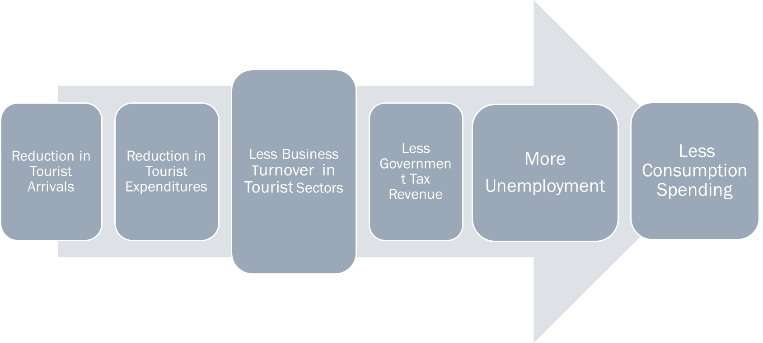
COVID-19 Territorial Economic Impact
Celebrate the People
Monthly Features of EDB and EZC Clients
Earned Media vs. Paid Media
Objective: Reduce advertising spending -> Increase storytelling worth sharing
Change the culture – Build Multigenerational Wealth
#BuildUSVI
Channels of Economic Shock Transmission-Warning Against Nonessential Travel/Cruise Ship Suspension
8

Slide 9
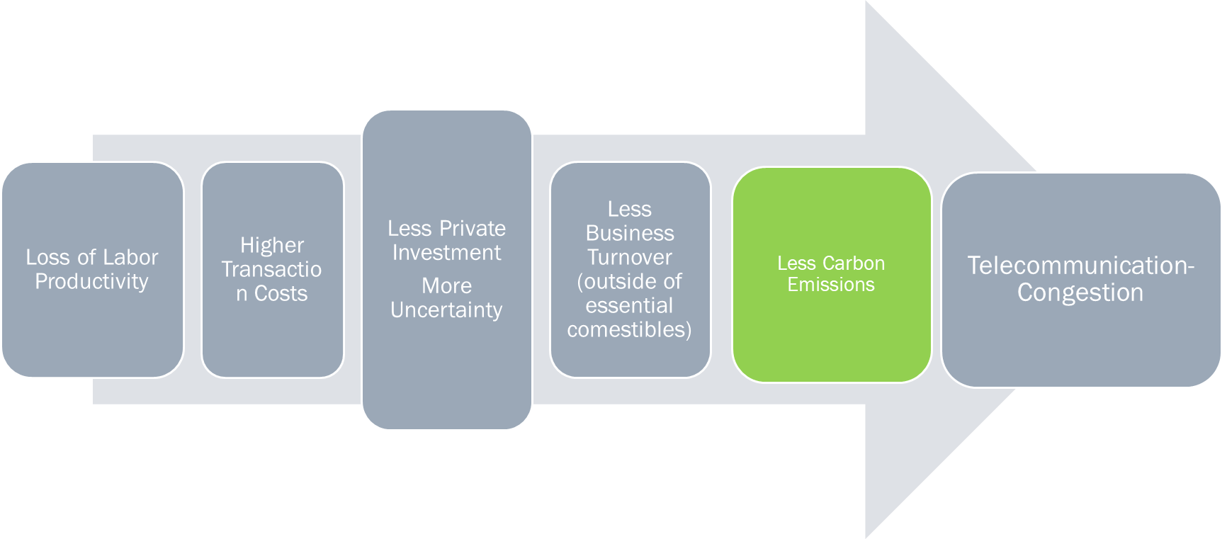
COVID-19 Territorial Economic Impact
Celebrate the People
Monthly Features of EDB and EZC Clients
Earned Media vs. Paid Media
Objective: Reduce advertising spending -> Increase storytelling worth sharing
Change the culture – Build Multigenerational Wealth
#BuildUSVI
9

Slide 10
COVID-19 Territorial Economic Impact
Celebrate the People
Monthly Features of EDB and EZC Clients
Earned Media vs. Paid Media
Objective: Reduce advertising spending -> Increase storytelling worth sharing
Change the culture – Build Multigenerational Wealth
#BuildUSVI
10

Slide 11
COVID-19 Economic Impact on Tourism Industry
Celebrate the People
Monthly Features of EDB and EZC Clients
Earned Media vs. Paid Media
Objective: Reduce advertising spending -> Increase storytelling worth sharing
Change the culture – Build Multigenerational Wealth
#BuildUSVI
11

Slide 12
Business Impact Survey
The United States Virgin Islands Economic Development Authority (USVIEDA) is seeking your assistance to assess the impact of the coronavirus (COVID-19) on our small business community. Please complete the survey and tell us what you are experiencing during the pandemic.
The survey is short and will take approx. 5-7 minutes to complete.
Link: https://www.surveymonkey.com/r/SmallBusinessImpactSurvey
Deadline to complete this survey is Tuesday March 31, 2020 at 5 p.m.
USVIEDA will use the information collected in this survey to create a rapid response to this ongoing crisis.
Redesign
Focus Groups
Final Product
August-September with Crucianpoint
September-November
Soft Launch February
External and Internal
Media Announcement April 1st
Since the launch of the new website, the www.usvieda.org has an 85% increase of users visiting the website in the same time period over 2018.
12

Slide 13
Together We will Thrive.
We Support Small Business.
www.usvieda.org
@usvieda
@usvi_eda

